Slide 1
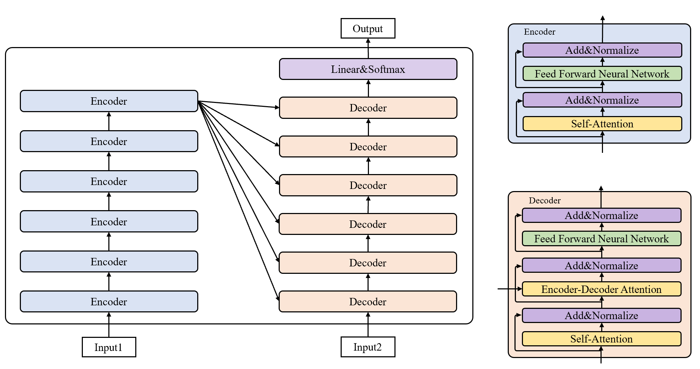

Slide 2
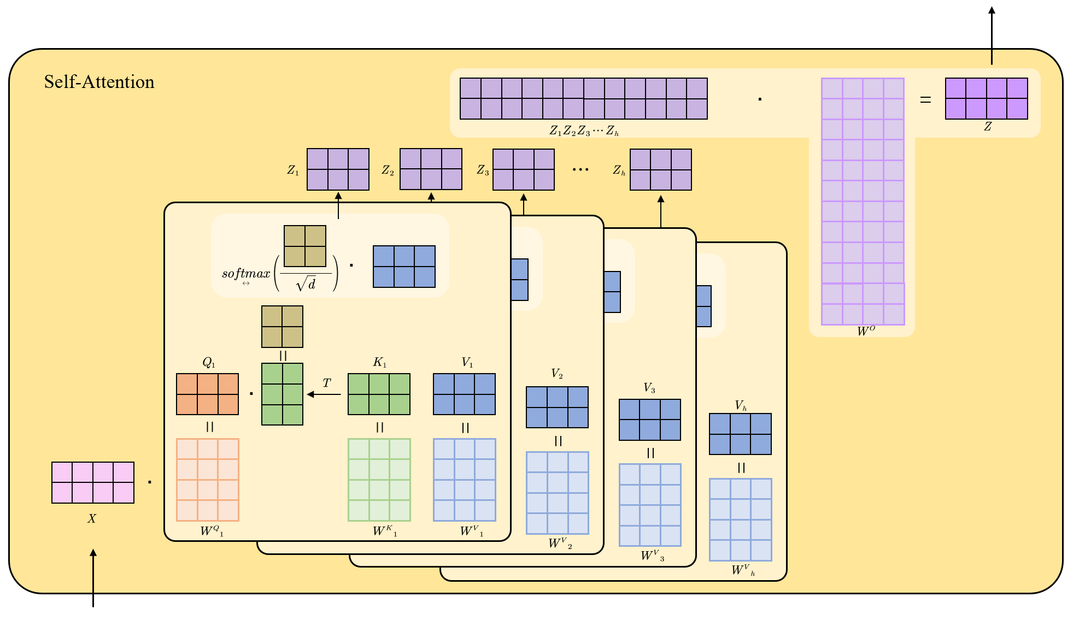

Slide 3
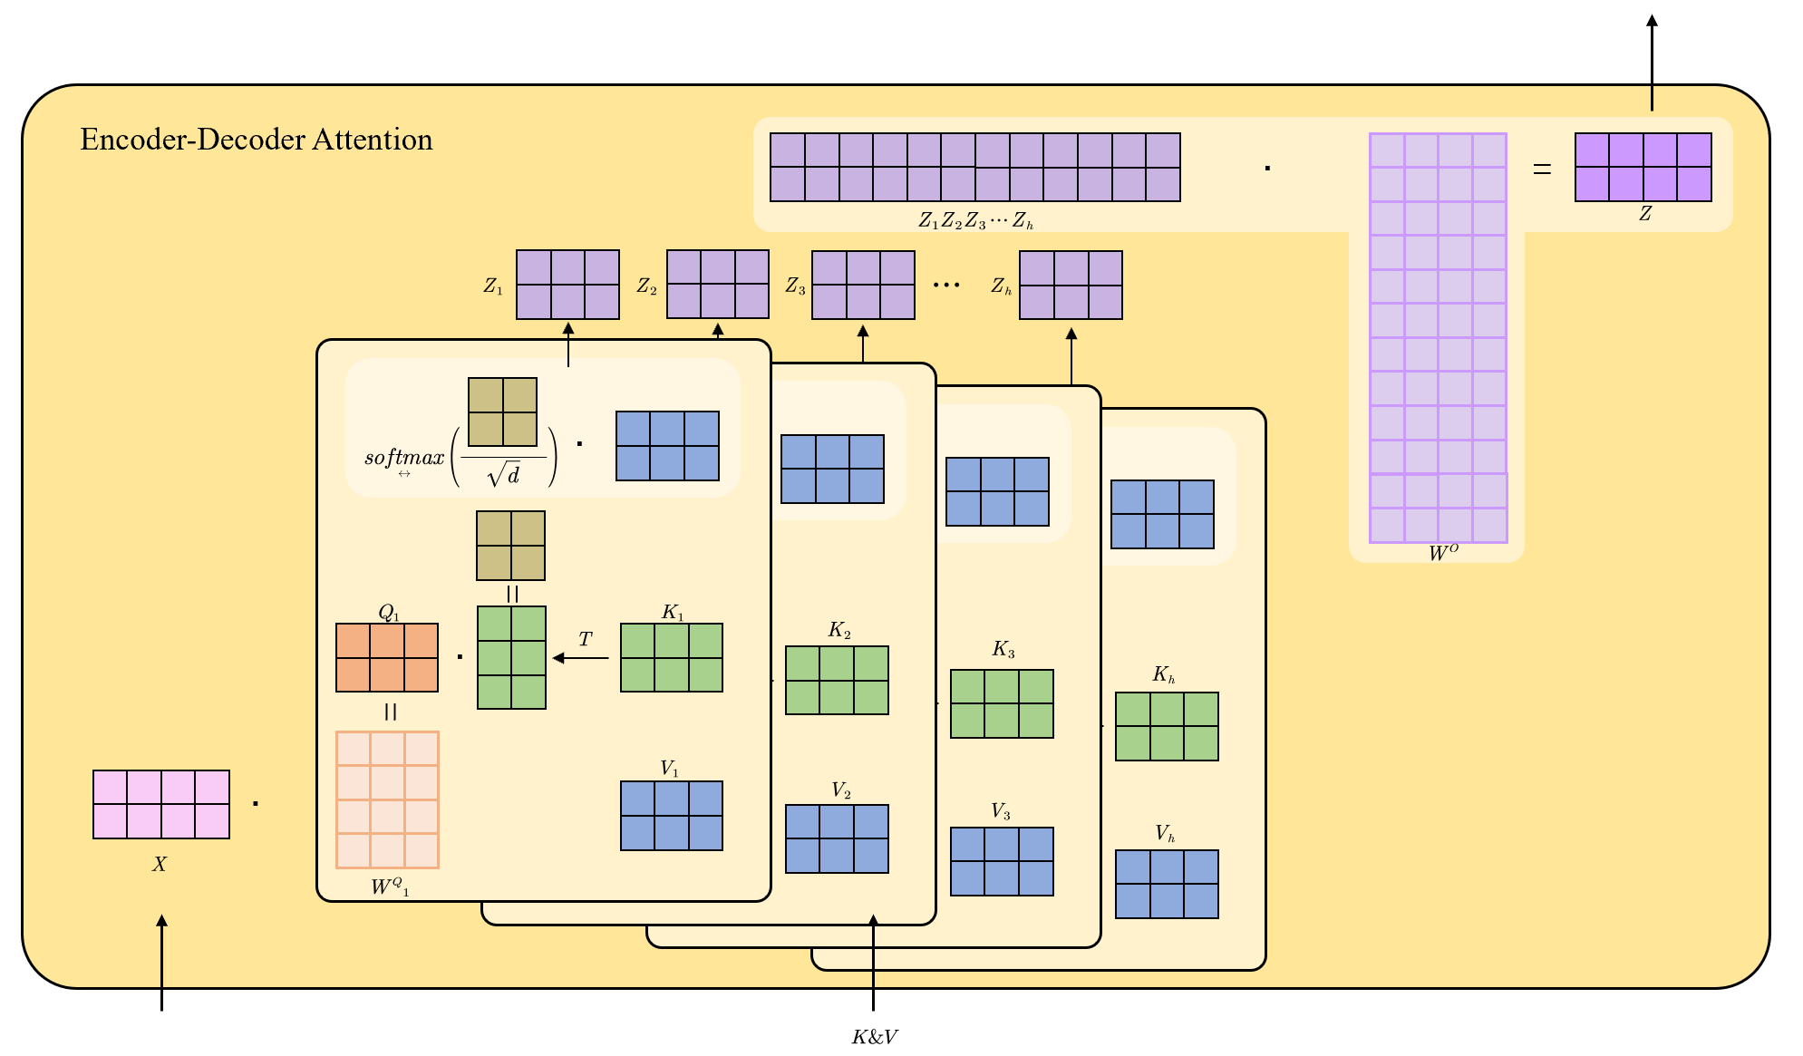

Slide 4
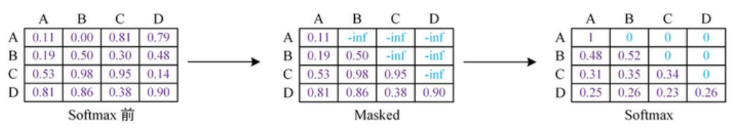
Mask
I love China
我爱中国
I
1 | 1 | 1 | 1
1 | 1 | 1 | 1
1 | 1 | 1 | 1
0 | 0 | 0 | 0
我
1 | 0 | 0 | 0
1 | 1 | 0 | 0
1 | 1 | 1 | 0
1 | 1 | 1 | 1
love
爱
China
中
<pad>
国

Slide 5
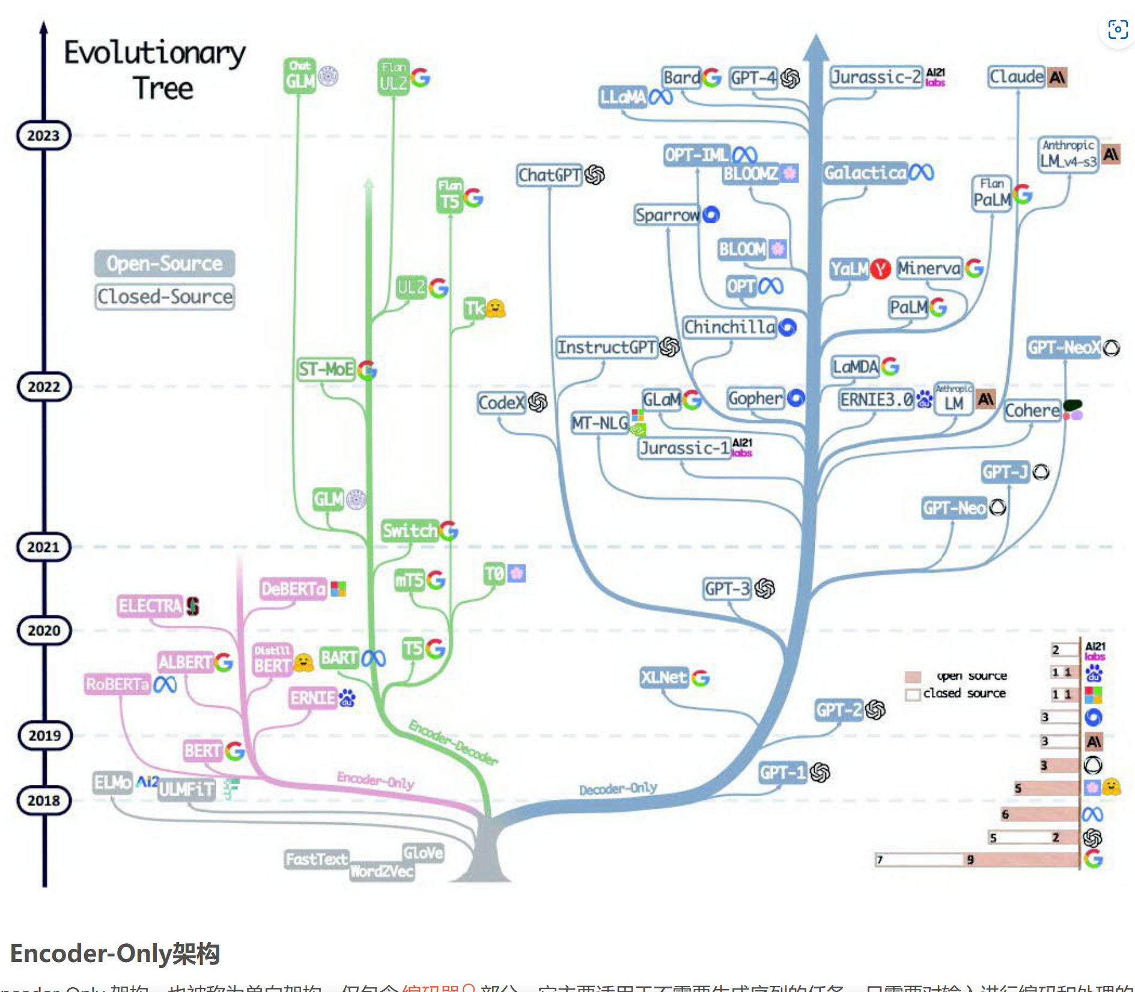

Slide 6
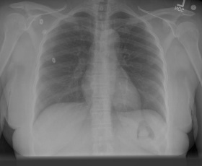
image_feat
Loss_IRC
text_feat
Loss_IRM
Loss_RG
Image Encoder
Text Encoder
Cross-modal Encoder
Language
Decoder
Lungs are clear. Heart size normal…

Slide 7
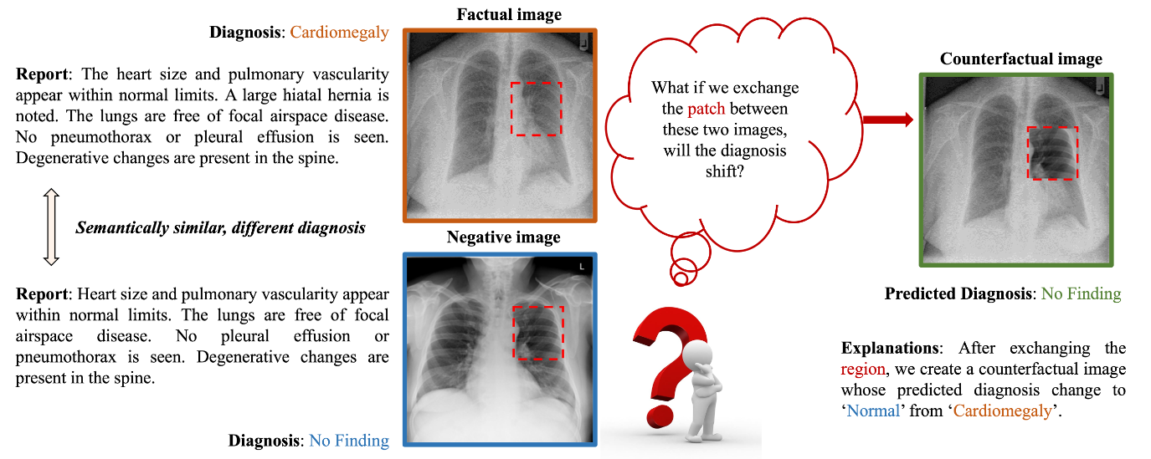

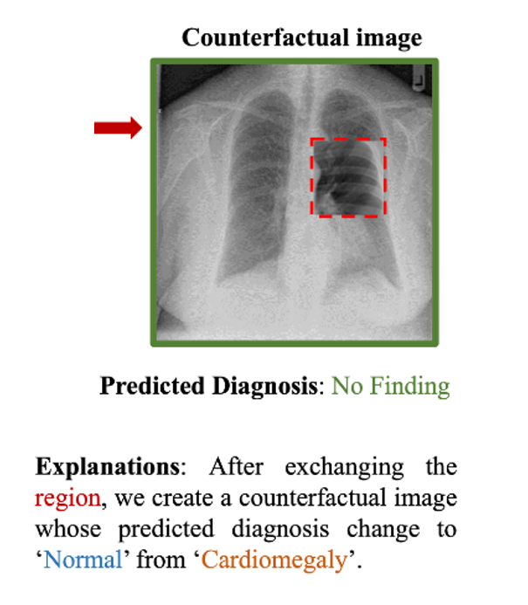

Slide 8
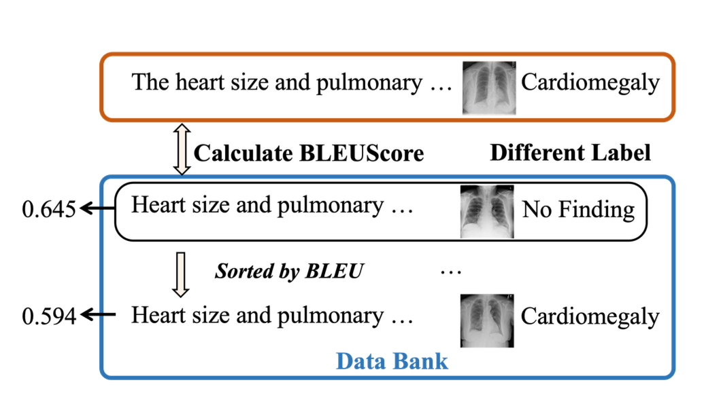
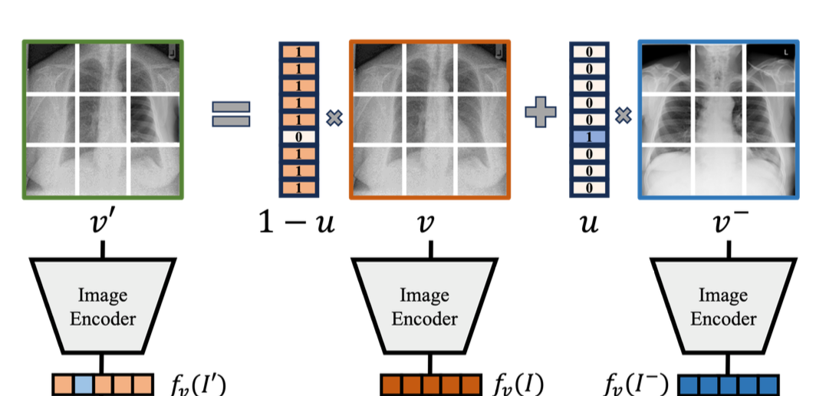
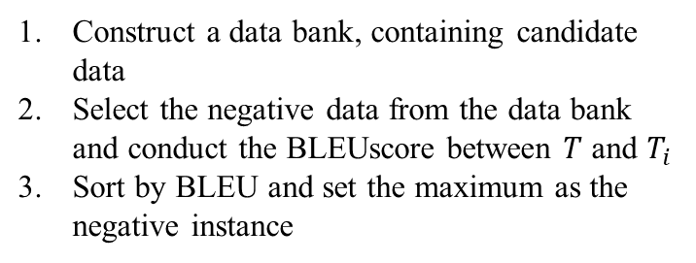

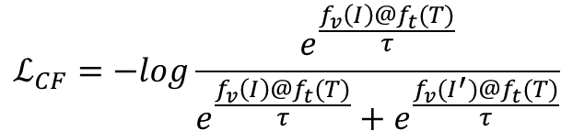
Negative sampling strategy
Construct a data bank, containing candidate data
Select the negative data from the data bank and conduct the BLEUscore between $T$ and $T_{i}$
Sort by BLEU and set the maximum as the negative instance
$$ℒ_{CF}=−log\frac{e^{\frac{f_{v}\left(I\right)@f_{t}(T)}{τ}}}{e^{\frac{f_{v}\left(I\right)@f_{t}(T)}{τ}}+e^{\frac{f_{v}(I^{′})@f_{t}(T)}{τ}}}$$
$ℒ=$ $ℒ_{IRC}+λ_{rg}$ $ℒ_{RG}+ℒ_{IRM}+λ_{cf} ℒ_{CF}$

Slide 9
Loss_ITC
image_feat
Loss_CF
text_feat
Loss_IRM
Loss_RG
Image Encoder
Text Encoder
Cross-modal Encoder
Counterfactual Generation Model
Language
Decoder
Negative data
Lungs are clear. Heart size normal…

